Slide 1
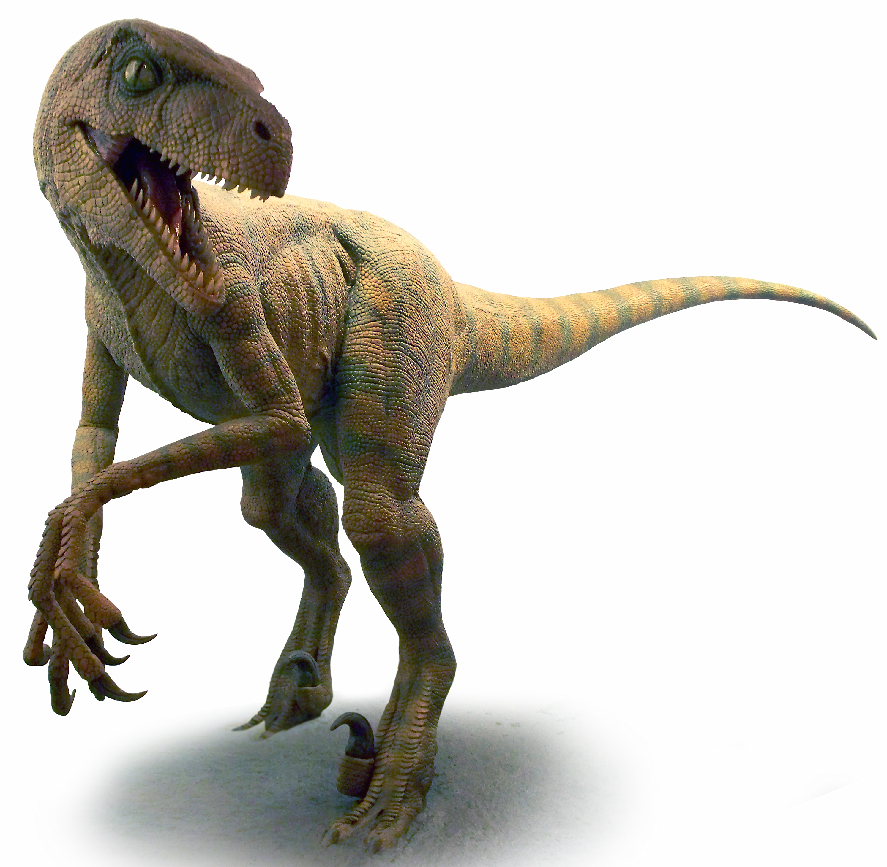
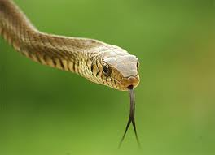
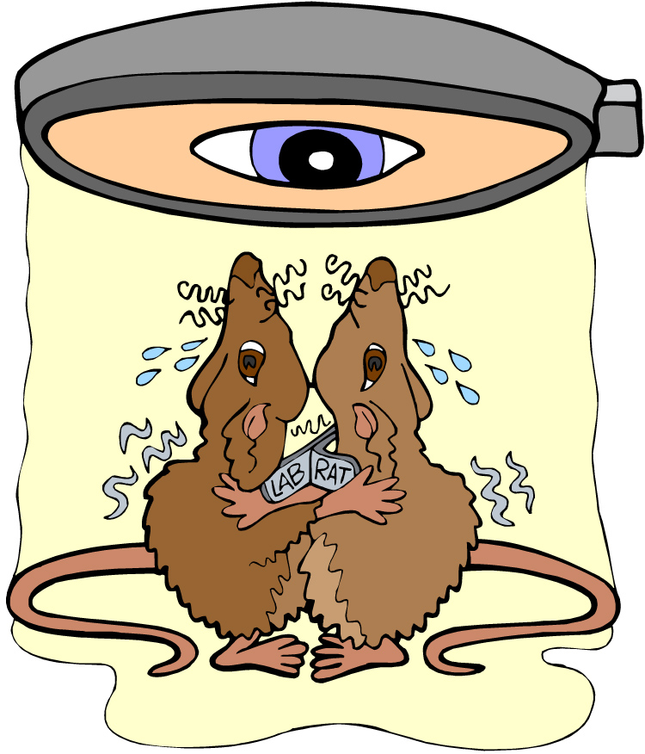

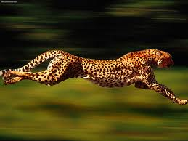
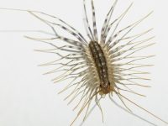


Introduction to Science
and the Scientific Method
© Amy Brown – Science Stuff

Slide 2
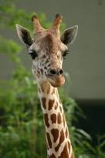
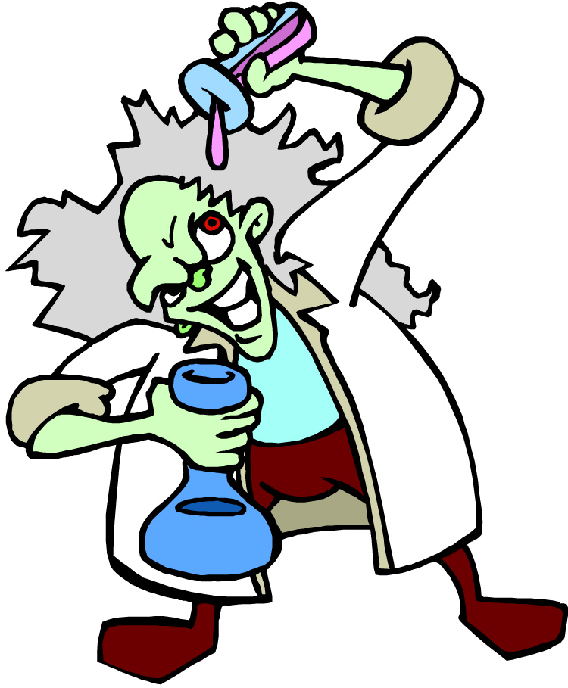
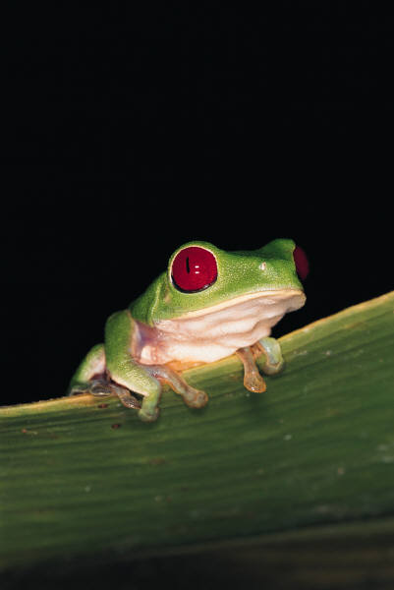
What is Science?
1. Science deals only with the natural world.
3. Scientists propose ___________ that can be ______ by examining evidence.
2. Scientists:
explanations
collect and organize information in a careful, orderly way, looking for patterns and connections.
tested

Slide 3

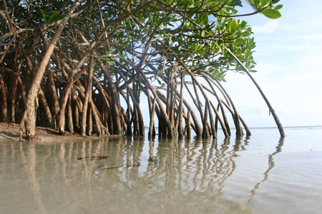
The goal of science is to investigate and understand nature, to explain events in nature, and to useful predictions.
This Photo by Unknown Author is licensed under CC BY-NC-ND

Slide 4

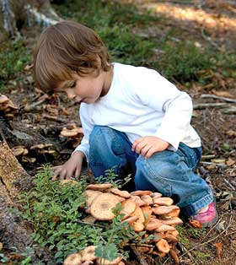
How is Science Done?
An observation is using one or more senses to gather information, called data.

Slide 5

There are two types of data:
Quantitative involves numbers or counting
Qualitative involves characteristics that are not easily measured (words, qualities: color, feel, smell, etc.

Slide 6
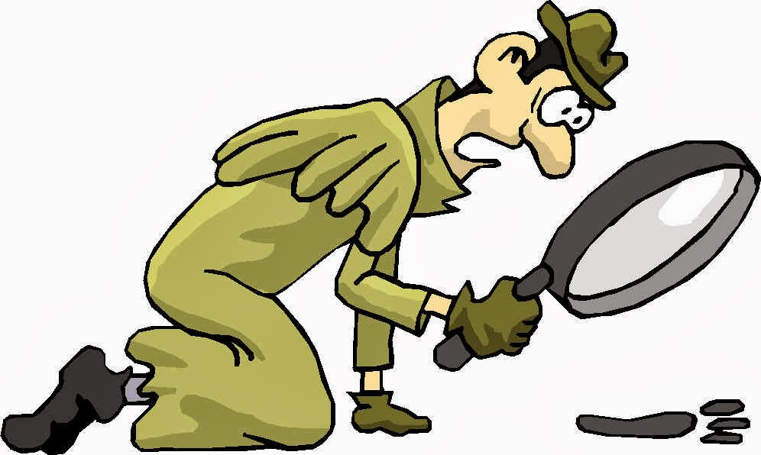
An inference is a logical explanation of the data based on prior knowledge and experience.
Example:
Observation – I
see footprints.
Inference – the
burglar must
have been here.
This Photo by Unknown Author is licensed under CC BY-SA

Slide 7
A hypothesis is NOT an educated guess!!!!! Rather, a possible explanation to the observations or an answer to a question that can be tested.
Experimental Needs
A Specific Question

Slide 8
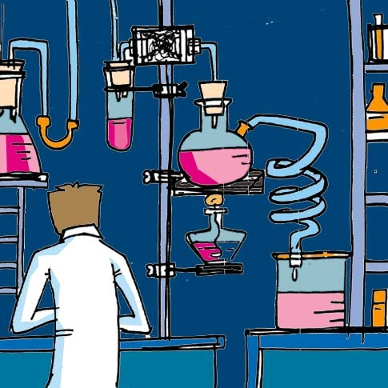

A hypothesis must be stated in a way that makes it “testable”.
Hypothesis statements should be written as an if/then statement. If I do this, then that will happen.

Slide 9
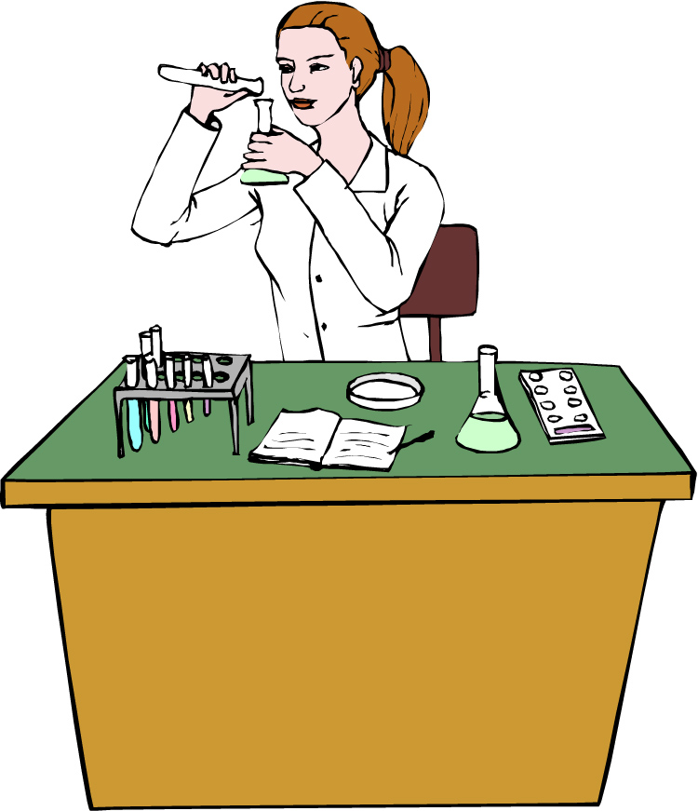
Scientific Methods
The scientific method is:
A series of steps used by scientists to solve a problem or answer a question.
The Steps to the Scientific Method
Observation / Asking a Question
Form a Hypothesis
Design a Controlled Experiment
Record and Analyze Results
Draw Conclusions

Slide 10


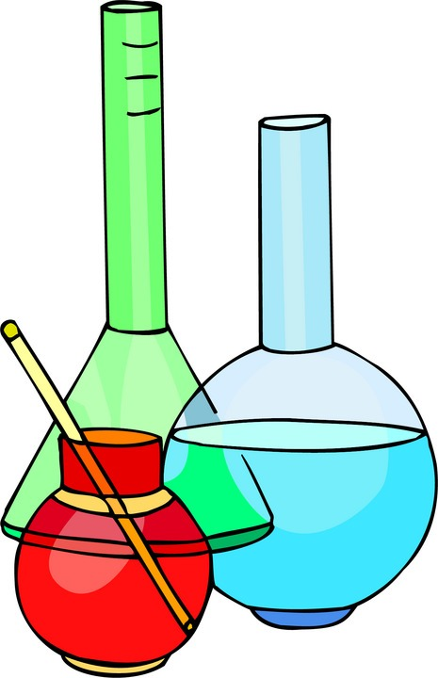
Step 1:
Observation / Asking a Question
Step 2: Form a Hypothesis
Hypothesis
A problem or a question must first be identified.
A possible explanation to the question or problem.
It is simply a prediction and has not yet been proven or disproven.
It must be stated in a way that is testable.
A statement is considered “testable” if evidence can be collected that either does or does not support it.
How much water can a root hair absorb?
Why does a plant stem bend toward the light?
What effect does temperature have on heart rate?

Slide 11
Step 3: Designing a Controlled Experiment
1. The factors in an experiment that can be changed are called variables. Some example of variables would be: changing the temperature, the amount of light present, time, concentration of solutions used.
2. A controlled experiment works with one variable at a time. If several variables were changed at the same time, the scientist would not know which variable was responsible for the observed results.
3. In a “controlled experiment” only one variable is changed at a time. All other variables should be unchanged or “controlled”.
4. An experiment is based on the comparison between a ____________ with an ________________.
control group
experimental group
a) These two groups are identical except for one factor.
b) The control group serves as the comparison. It is the same as the experiment group, except that the one variable that is being tested is removed.
c) The experimental group shows the effect of the variable that is being tested.

Slide 12
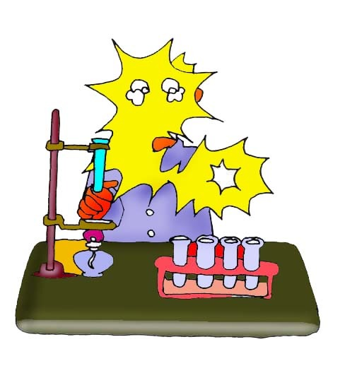
Example: In order to test the effectiveness of a new vaccine, 50 volunteers are selected and divided into two groups. One group will be the control group and the other will be the experimental group. Both groups are given a pill to take that is identical in size, shape, color and texture.
Even though the volunteers are given identical looking pills, the control group will not actually receive the vaccine.
Describe the control group.
Describe the experimental group.
What variables are kept constant?
What variable is being changed?
This group will receive the vaccine.
The size, shape, color, and texture of the pill.
Whether or not the pill contains the vaccine.

Slide 13
There are two variables in an experiment:
c) In the above example, what is the independent variable?
a) The independent variable is the variable that is deliberately changed by the scientist.
It is the addition of the vaccine to the pills that were given to the volunteers.
b) The dependent variable is the one observed during the experiment. The dependent variable is the data we collect during the experiment. This data is collected as a result of changing the independent variable.
d) In the above example, what is the dependent variable?
The observed health of the people receiving the pills.

Slide 14
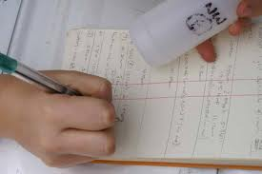
Step 4: Recording and Analyzing Results
1. The data that has been collected must be organized and analyzed to determine whether the data are reliable.
2. Does the data support or not support the hypothesis?

Slide 15

Step 5: Drawing Conclusions
The evidence from the experiment is used to determine if the hypothesis is proven or disproven.
Experiments must be repeated over and over. When repeated, the results should always be the same before a valid conclusion can be reached.

