Slide 1
Unit 2: Classification of Living Things How do scientists know living things are related?

Slide 2
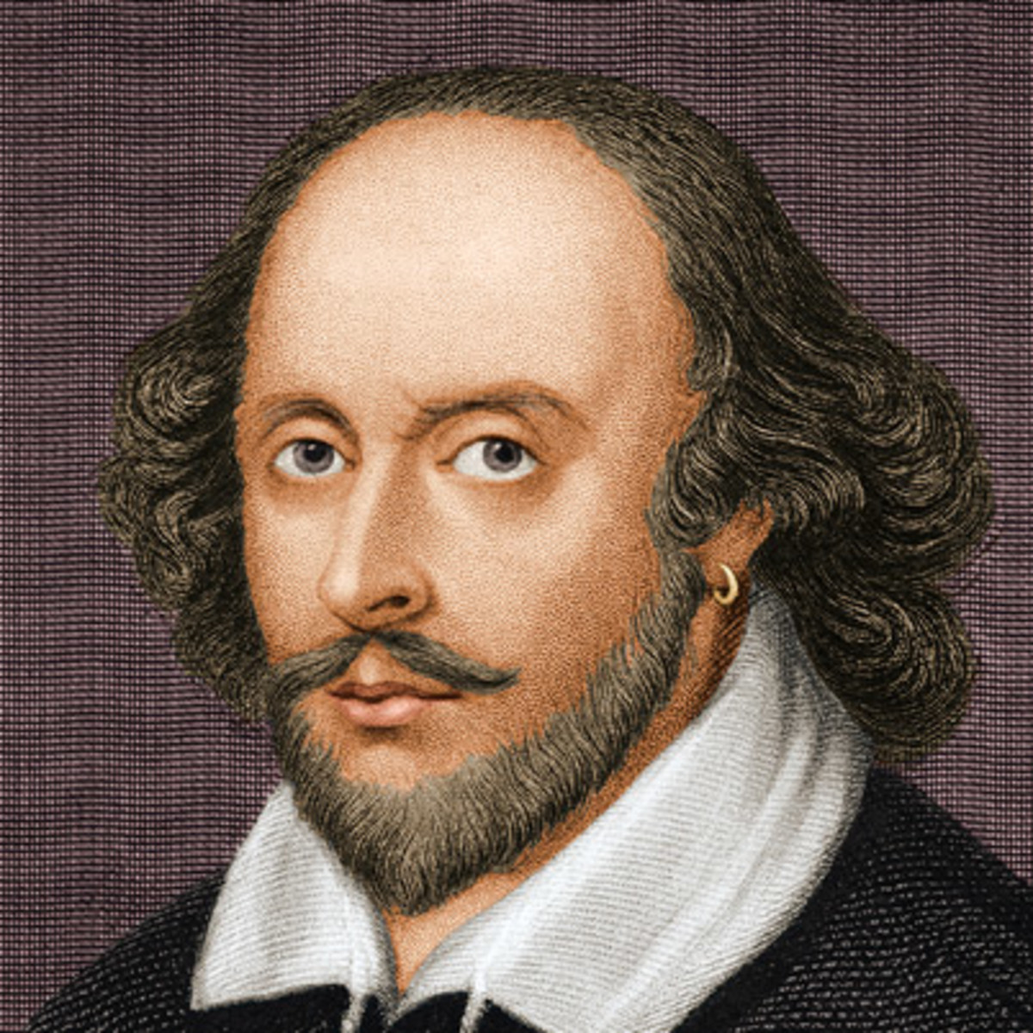
What's in a name?
“That which we call a rose By any other word would smell as sweet.”
--William Shakespeare

Slide 3
Do you think the following statements are true or false?
1. The classification system used today has changed very little since it was introduced: T/F
2. To be classified as an animal, an organism must have a backbone: T/F
3. Organisms can be classified according to whether they have nuclei in their cells: T/F
4. Scientists can study genetic material to classify organisms: T/F
5. Organisms that have many physical similarities are always related: T/F

Slide 4
True or false…
1. The classification system used today has changed very little since it was introduced: T/F
2. To be classified as an animal, an organism must have a backbone: T/F
3. Organisms can be classified according to whether they have nuclei in their cells: T/F
4. Scientists can study genetic material to classify organisms: T/F
5. Organisms that have many physical similarities are always related: T/F

Slide 5
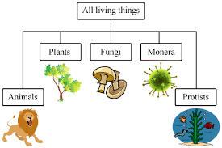
Why do we classify living things?
Classification helps scientists answer questions such as:
How many kinds of living things are there?
What characteristics define each kind of living things?
What are the relationships among living things?

Slide 6
How do you know living things are related?
Physical characteristics:
Skeletal structures
How organisms develop from egg to adult
Animals with similar skeletons may be related
Chemical characteristics

Slide 7
How are living things named?
Scientific names follow a specific set of rules.
Scientists use a two-name system called a Binomial Naming System.
Scientists name animals and plants using the system that describes the genus and species of the organism.
The first word is the genus and the second is the species.

Slide 8
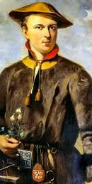
What’s in a name?
A Swedish naturalist named Carolus Linnaeus is considered the 'Father of Taxonomy' because, in the 1700s, he developed a way to name and organize species that we still use today.
Linnaeus is famous for his work in Taxonomy
Taxonomy is the part of science that focuses on naming and classifying or grouping organisms

Slide 9
Think about it….
Why have scientific names?

Slide 10
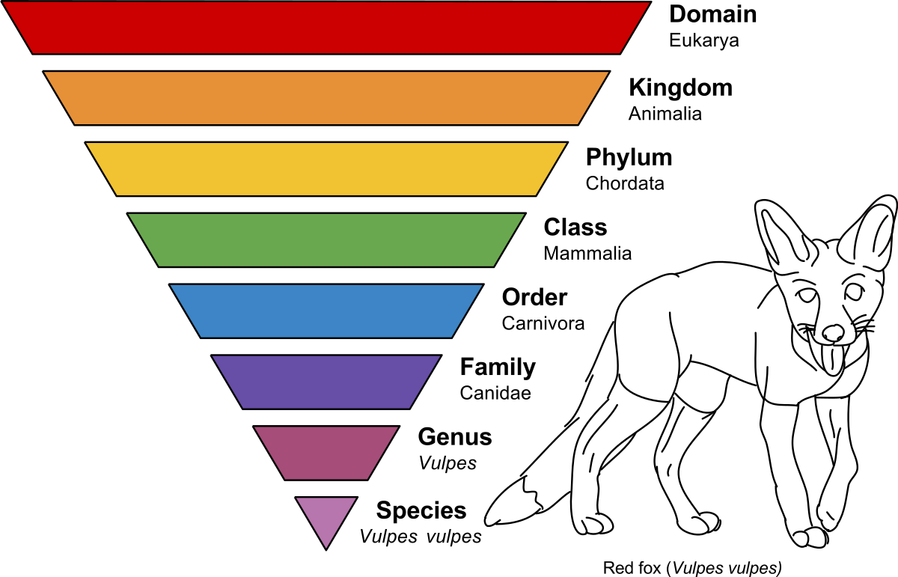
What are the levels of classification?
Domain, Kingdom, Phylum, Class, Order, Family, Genus, and Species
Each level contains organisms with
similar characteristics.
The level at the top is the largest group
and is very broad.

Slide 11
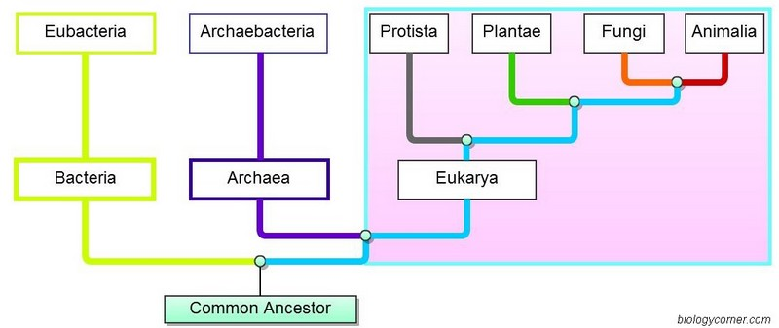
What are the three domains?
Archaea, Bacteria, and Eukarya.
The first two are all prokaryotic microorganisms, or single-celled organisms whose cells have no nucleus.
The third group are eukaryotic organisms that have a nucleus and other membrane bound organelles

Slide 12
What are the four kingdoms of Eukarya?
Eukaryotes represent a domain of life in which there are multiple kingdoms.
The most common classification creates four kingdoms in this domain: Protista, Fungi, Plantae, and Animalia.

Slide 13
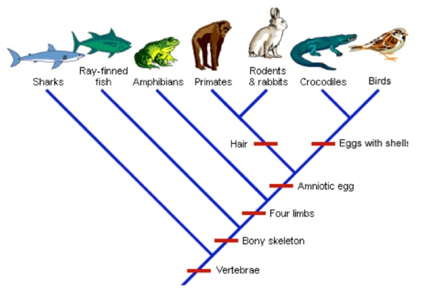
How do branching diagrams show classification relationships?
A cladogram shows relationships between species
Organisms are grouped according to common characteristics

Slide 14
How can organisms be identified?
Imagine walking through the woods… you see an animal sitting on a tree branch…it has wings, a beak, and bright yellow eyes…
What is it?
You can use this really cool thing called a dichotomous key to figure it out!!
These keys use a series of paired statements to identify organisms. More on that later….

Slide 15
Vocabulary
Species
Genus
Domain
Bacteria
Archaea
Eukarya
Protista
Fungi
Plantae
Animalia
Binomial Nomenclature

