Slide 1
Unit 2: Forces and Changes in Motion
Part 1 : Force
Part 2 – Balanced and Un balanced Forces

Slide 2
Part 1 - Essential Question: What are the different types of forces and how do they act on objects?

Slide 3
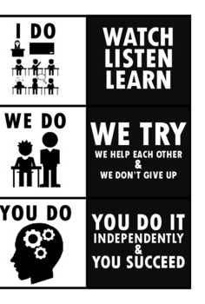
Introduction to I do, WE do YOU do:
I do – You are watching me, listening and learn. I will show you what you need to fill in on your handout
WE – an activity or part of your notes I help you complete; may also be done in small groups
YOU do – you complete on your own, following
C-U-B-E
whenever possible)
Circle vocab words
Underline important word
Box in the question
Eliminate the wrong answers

Slide 4

Bell Ringer please answer this on your bell worksheet
James is riding a bike down a hill. As he gets to the bottom, he applies the brakes to stop the bike’s forward motion. Which of the following statements best describes an example of friction acting on the bicycle?
A. The ground pushing up on the bike
B. James is hands squeezing the handle of the brakes
C. James is body pressing down on the seat of the bike
D. The surface of the brake rubbing the rim of the front tire

Slide 5
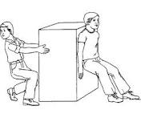
What is “force?”
a push or pull upon an object resulting from the object’s interaction with another object.
can act with or without direct contact.
may or may not cause movement
If an object is moving, a force will speed it up, slow it down or change direction; if an object is at rest, a force can get it moving

Slide 6

Two Types of Forces
“I do”
Contact (normal) Force - objects are touching, or in direct contact
Non-Contact Forces - forces act at a distance

Slide 7
Two Types of Forces
“I do”
Contact Force (objects will be found touching) | Non-Contact Forces (forces act at a distance)
-Applied force (Push/Pull) -Normal force (Floor/Ground Pushing You Up) -Friction | -Gravity -Electrical force -Magnetic force
Contact Force (objects will be found touching) | Non-Contact Forces (forces act at a distance)

Slide 8

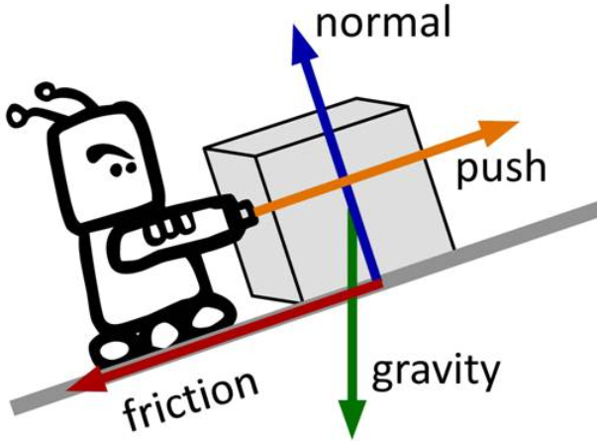
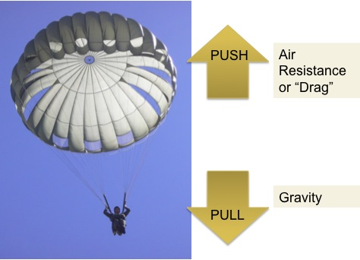
Contact forces- types of forces that result when two objects are physically in contact with each other.
Examples:
-Applied force (a push or pull)
-Normal force (floor or ground pushing you up)
-Friction

Slide 9


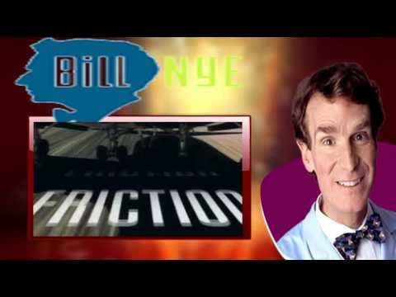






Friction - the resistance of motion when one object rubs against another
Bill Nye Friction
FRICTION
JUST KIDDING…

Slide 10
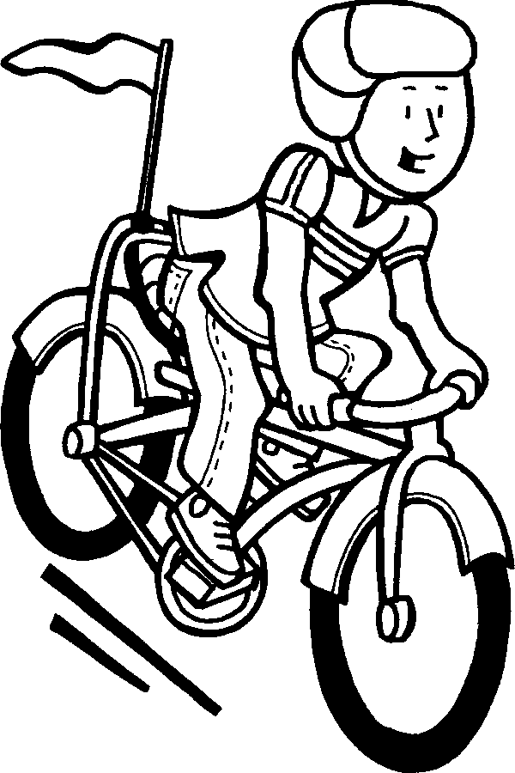
Let’s Re-Visit the Bell Ringer
James is riding a bike down a hill. As he gets to
the bottom, he applies the brakes to stop the bike’s
forward motion. Which of the following statements
best describes an example of friction
acting on the bicycle?
A. The ground pushing up on the bike
B. James is hands squeezing the handle of the brakes
C. James is body pressing down on the seat of the bike
D. The surface of the brake rubbing the rim of the
front tire
This Photo by Unknown Author is licensed under CC BY-NC-ND

Slide 11
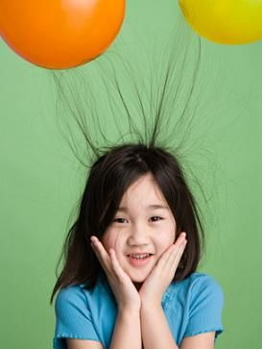
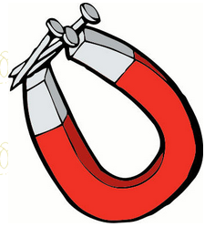
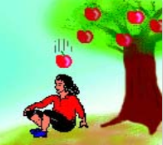
Non-Contact Forces – types forces that act at a distance
- a push or pull without touching
  Electrical force – force between two charged objects
    static cling
  Magnetic Force – force of attraction or
  repulsion between two magnetic poles
    magnetic substance: iron, cobalt an nickel
  Gravitational Force - the force of attraction between two objects with mass
    an apple falling on your head

Slide 12

Electrical Force
Demonstration: Stick Around
This Photo by Unknown Author is licensed under CC BY-NC-ND

Slide 13
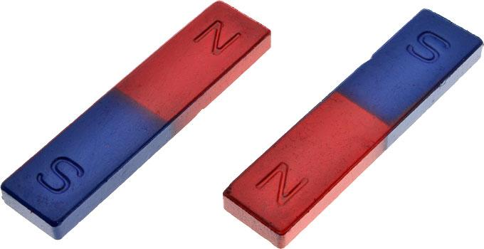
How do magnets work?
A magnet has 2 poles or ends, north and south.
Opposite poles are attracted to each other, while the same poles repel each other
Magnetism is a force that works from a distance depending on the strength of the magnet
Watch This!
YOU do: on your notes draw a quick sketch that shows how the magnets above will repel each other and attract each other.

Slide 14



Gravitational Force (gravity) - the force that acts between any two masses
Mass- the measure of an amount of matter in an object
  The more mass an object has, the greater the gravitational force between it and other objects.
Matter – anything that has mass and takes up space
Distance - as distance increases between two objects, the gravitational force will decrease.
Weight- the amount of gravitational pull on an object
ADD THESE DIAGRAMS TO YOUR NOTES

Slide 15
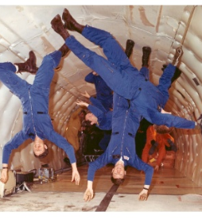
The Law of Universal Gravity
Do you remember what a law is?
The force of gravity acts between all objects in the universe
  You are attracted to Earth and everything around you
  Gravity is the force that keep the moon orbiting the earth and all of the planets orbiting the sun
  Gravity always pulls down toward the center of the earth
  Earth pulls on objects even when there are other objects in between

Slide 16
YOU do –
Remember :
Circle vocab words
Underline important words
Box in the question
Eliminate the wrong answers
“YOU do”

Slide 17
1. A group of people rented a fishing boat for the day and traveled far from land. Later they discovered they needed a compass to find their way back. Which of the following describes the force acting on the compass to guide them safely back to land?
Gravity
Electrical Force
Magnetic Force
Friction
“YOU DO” (1 of 3)

Slide 18
“YOU DO” (2 of 3)
2. In 1969, Neil Armstrong became the first person to walk on the Moon. Video coverage showing the astronaut walking on the surface of the Moon gives the impression that he was bouncing while he walked. What is the reason for this?
The astronaut's mass on the Moon decreases.
The density of the astronaut on the Moon is higher than on Earth.
The atmosphere of the Moon affects the way the astronaut is able to move.
The astronaut's weight on the Moon depends on the Moon's gravitational force.
Notes:
Correct Answer: D

Slide 19
“YOU DO” (3 of 3)
Refer to the picture of the satellite orbiting the Earth to help you answer this question.
3. According to the Law of Universal Gravitation, which satellite would experience the least amount of gravitational attraction to the Earth?
Satellite A
Satellite B
Satellite C
Satellite D
Notes:
Correct Answer: D

Slide 20
Revisit Bell Ringer
James is riding a bike down a hill. As he gets to the bottom, he applies the brakes to stop the brakes forward motion. Which of the following statements best describes an example of friction acting on the bicycle?
A. The ground pushing up on the bike
B. James is hands squeezing the handle of the brakes
C. James is body pressing down on the seat of the bike
D. The surface of the brake rubbing the rim of the front tire*
Notes:
Correct Answer: D

Slide 21
Essential Question: Can you describe the different types of forces and describe how they act on objects?

Slide 22


Part 2: Balanced and
Unbalanced Forces
Essential Questions:
What are balanced and unbalanced forces?
How do unbalanced forces cause a change in an objects position, direction and speed?

Slide 23
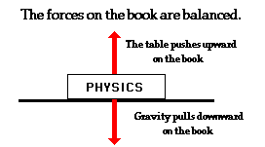
Balanced Force – two forces, equal in size, acting in opposite directions on an object
Anytime there is balanced force on an object, the object stays still OR continues to move at the same speed in the same direction.
The book does not move

Slide 24
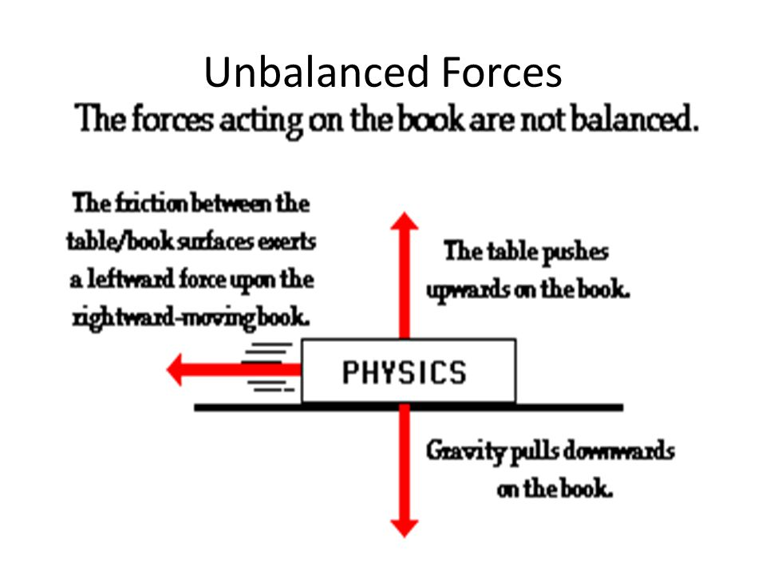
Unbalanced force – two forces that are not equal in size act on an object
Can cause an object to
  Speed up
  Slow down
  Stop
  Change direction
Always cause a change in motion
in one of these ways:
  Direction of Motion
  Speed
  Direction and Speed

Slide 25
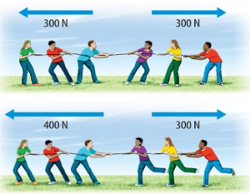
Net Force – the sum of all the forces acting on an object
Measured in Newtons (N)
Balanced forces – net force = 0, motion stays the same (no movement)
Unbalanced forces – net force is NOT 0, motion will change (movement)

Slide 26
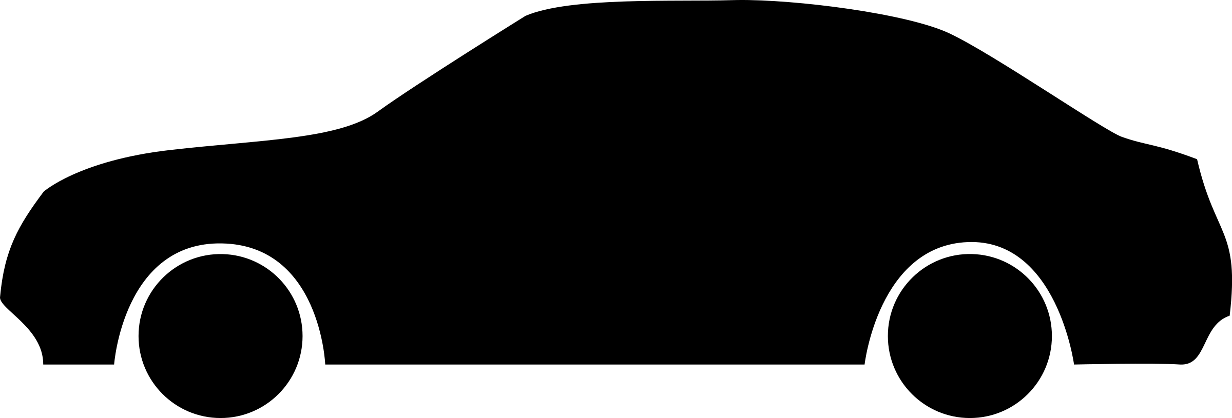
Speed – amount of distance traveled divided by time – 55 mph (miles per hour, miles / hour)
Velocity - the rate at which an object changes its position in a specific direction (speed + a direction)
- distance traveled divided by time and add a direction to it: 55mph North

Slide 27
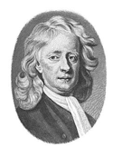
Isaac Newton – very influential English physicist and mathematician in the 1600’s
3 laws of motion (Newton’s Laws of Motion)
  1 – Inertia
  2 – Force and Acceleration
  3 – Action and Reaction
  Recall: what is a law?

Slide 28

Inertia – the property of an object, due to its mass, by which it resists any change in its position unless overcome by a force
Newton’s First Law – The Law of Inertia
1
  An object at rest tends to stay at rest and an object in motion tends to stay in motion.
  More specifically, if there is no force, an object at rest will stay at rest and an object in motion will continue to move in the same direction at the same speed.
Recall: what makes this a law rather than a theory?

Slide 29
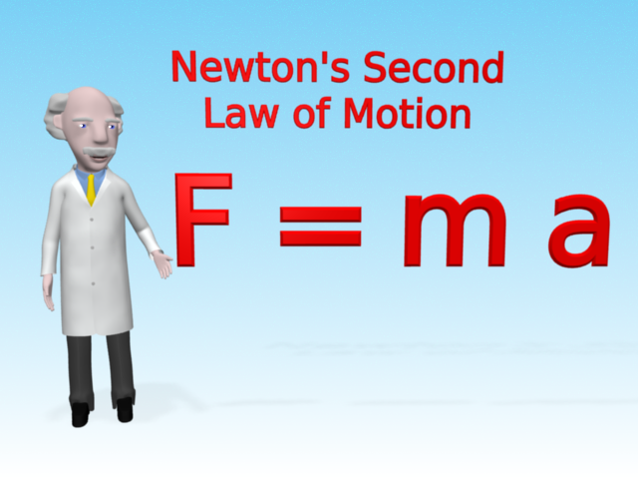


Acceleration - The rate at which an object changes its speed or direction (speeding up, slowing down, or changing direction)
Newton’s Second Law
2
The acceleration of an object depends on its mass and force.
  a = acceleration
  m = mass
  F = force
F
m a
This Photo by Unknown Author is licensed under CC BY-NC-ND

Slide 30
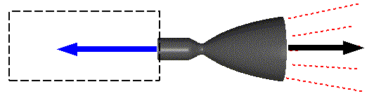
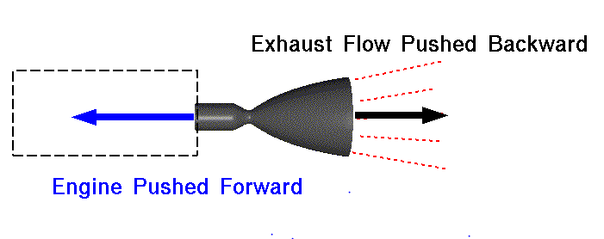
3
Newton’s Third Law
For every action there is an equal and opposite reaction
- an action is a force
Can you explain how a rocket launches using this law?

Slide 31
A Quick Review
www.studyjams.com
- Force and motion

